Slide 1
Unlocking the potential of Large Language Models (LLMs).
(AI)
1
1

Slide 2



About Me ☺
Role : I'm Engr. Soonh Taj, a PhD scholar & CS faculty at SIBAU.
Expertise - NLP and AI research.
Education - BE & ME from MUET Jamshoro.
Research Alumni - NTNU Gjøvik.
Involvement: Active in academia & community
Contact: engr.soonhtaj@gmail.com for any inquiries.
LinkedIn:
Soonh Taj (Speaker) linkedin.com/in/engr-soonh-taj
Aftab Ahmed (Organizer / Gold MLSA): https://www.linkedin.com/in/aftabahmedabro/
2

Slide 3
Table of contents
02
03
04
05
01
LLMs Introduction
Architecture of LLMs
Popular LLMs
Hands on LLMs
Applications of LLMs
06
Challenges
3

Slide 4
1
LLMs Introduction
(AI)
4

Slide 5
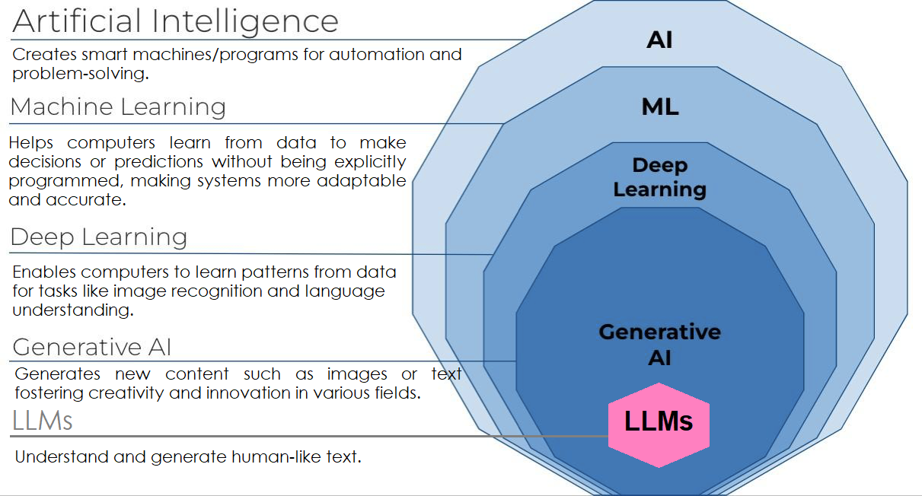
LLMs Introduction
1
5

Slide 6
2
Architecture of LLMs
(AI)
6

Slide 7
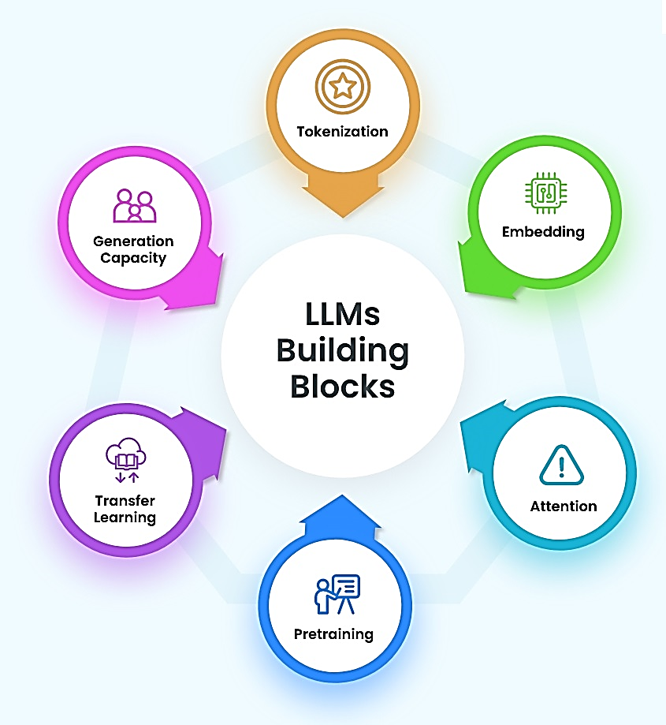
Architecture of LLMs
2
7

Slide 8
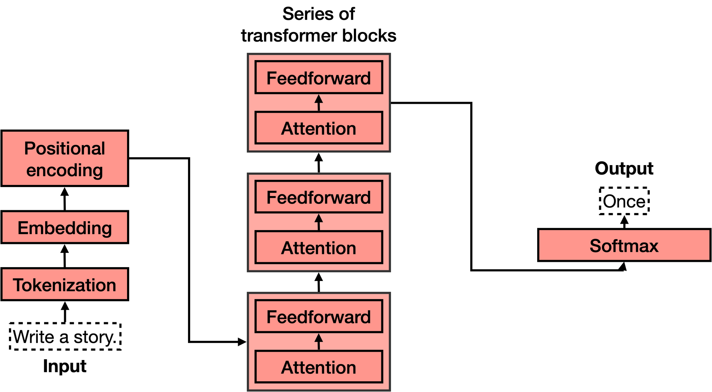
Architecture of LLMs
2
8

Slide 9
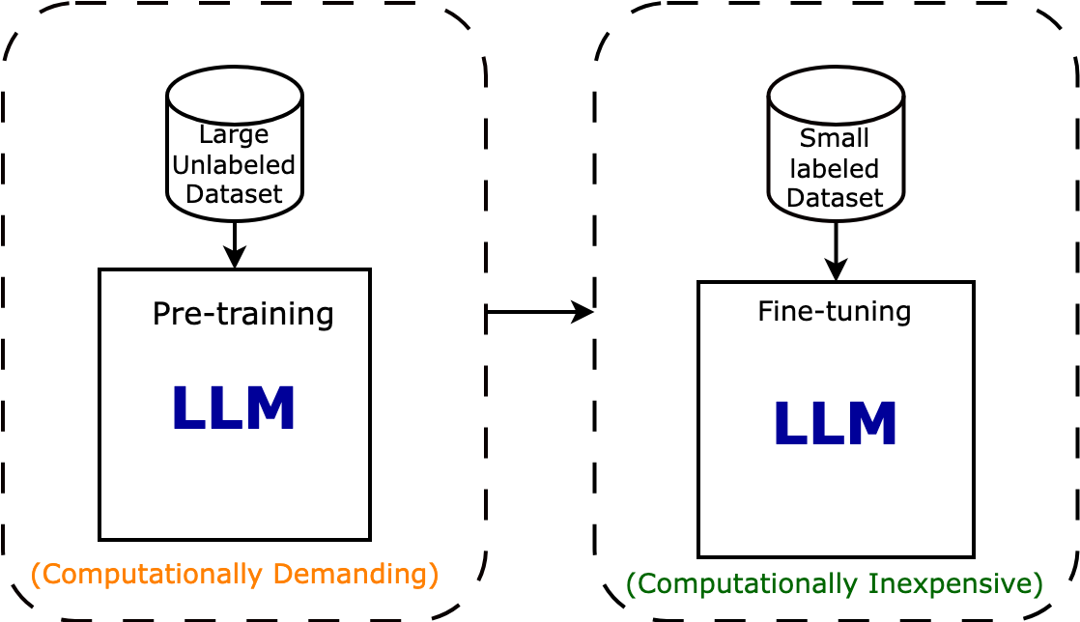
Architecture of LLMs
2
9

Slide 10
3
Popular LLMs
(AI)
10

Slide 11
Popular LLMs
3
LLM Name | Developed By | Model Size | Tasks | Link
GPT-3 | OpenAI | 175B | Text generation, Translation, Summarization & Text classification | https://platform.openai.com/docs/models/gpt-3-5-turbo
GPT-4 | OpenAI | 100T | Multimodal, Various tasks on text, images & code. | https://platform.openai.com/docs/models/gpt-4-and-gpt-4-turbo
PaLM 2 | Google AI | 540B | Multilingual, Text generation, Translation, Summarization & Text classification | https://ai.google/discover/palm2/
GEMINI | Google AI | 175 T(Ultra), 50T (Pro), 10T(Nano) | Multimodal, Various tasks on text, audio, images, video, and code. | https://deepmind.google/technologies/gemini/#introduction
BLOOM | BigScience | 176B | Multilingual, Text generation, Information Extraction, Question Answering, Summarization | https://bigscience.huggingface.co/blog/bloom
LLAMA 2 | Meta AI | 7B, 13B and 70B | Text generation, Translation, Summarization & Text classification | https://llama.meta.com/llama2/
11

Slide 12
4
Hands on LLMs
(AI)
12

Slide 13

Hands on LLMs
4
GPT
GPT (Generative Pre-trained Transformer) is a large-scale language model developed by OpenAI.
It is pre-trained on extensive text data using unsupervised learning techniques.
GPT utilizes the Transformer architecture, incorporating self-attention mechanisms for efficient processing of input sequences.
The model can generate coherent text given a prompt and adapt to specific tasks through fine-tuning.
GPT comes in various sizes, with larger models having more parameters to capture complex language patterns.
13

Slide 14
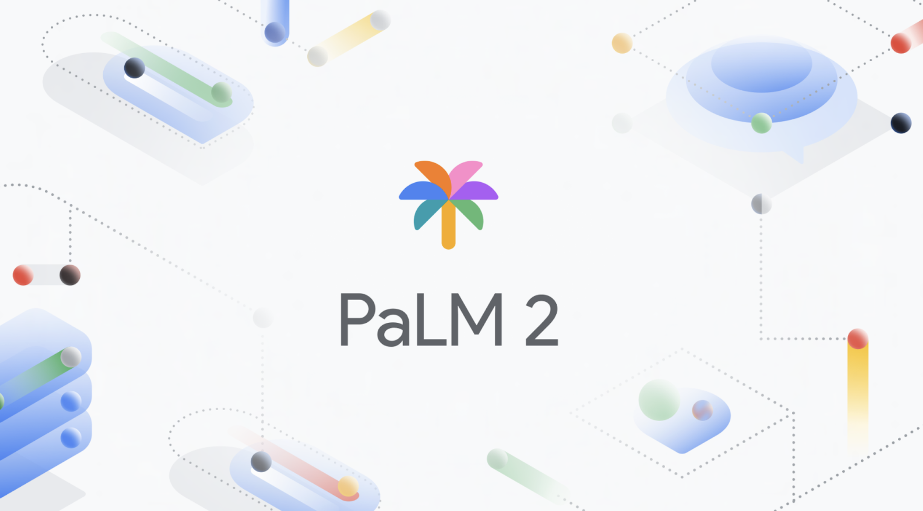
Hands on LLMs
4
Palm
Pathways Language Model (PaLM)
https://ai.google.dev/models/palm
https://poe.com/Google-PaLM
14

Slide 15

Hands on LLMs
4
Gemini
Multimodal LLM by Google AI.
https://ai.google.dev/models/gemini
15

Slide 16
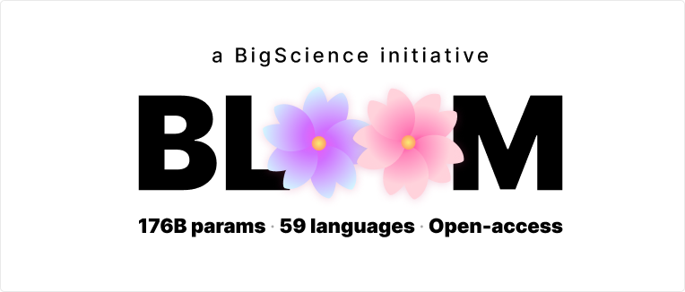
Hands on LLMs
4
Bloom
A 176B parameter multilingual LLM developed collaboratively by BigScience, involving numerous global researchers and institutions.
Open Source: Unlike counterparts like OpenAI, Meta, and Google, Bloom is entirely open source.
Huggingface providing access to the full Bloom model and smaller pre-trained versions through their transformers API.
https://huggingface.co/bigscience/bloom
16

Slide 17
Hands on LLMs
4
Bloom
1. Greedy Search:
Selects the word with the highest probability at each step, often leading to locally optimal choices but potentially missing better options later on.
Example: "The cat is" - If "cat" is followed by "sleeping" with the highest probability and "playing" with a slightly lower probability, greedy search would choose "sleeping" without considering "playing."
17

Slide 18
Hands on LLMs
4
Bloom
2. Beam Search:
Explores multiple potential sequences simultaneously by keeping track of the top-n most likely options at each step, aiming to find the most probable sequence overall.
Example: In beam search with a beam width of 2, if the options after "cat" are "sleeping," "playing," "eating," and "running," beam search would consider "sleeping" and "playing" as potential next words.
18

Slide 19
Hands on LLMs
4
Bloom
3. Sampling With Top-k + Top-p:
Balances randomness and control in text generation by first narrowing down the options to the top-k most likely words and then further refining the selection based on a probability threshold p.
Example: Suppose the top 3 words after "cat" are "sleeping," "playing," and "eating." Using Top-k sampling with k=1 and Top-p sampling with p=0.6, we might randomly select "sleeping" or choose words whose cumulative probability exceeds 0.6.
19

Slide 20
5
Applications of LLMs
(AI)
20

Slide 21
Applications of LLMs
5
Content Creation & Editing: Generate creative text formats, write marketing copy, translate languages, summarize information, and assist with writing tasks.
Information Access & Analysis: Answer your questions in an informative way, analyze large datasets, generate reports, and categorize information.
Human-Computer Interaction: Enhance chatbots and assistants, personalize user experiences, generate captions, and develop adaptive educational tools.
Code & Software Development: Write basic code, assist with debugging, automate tasks, and generate documentation.
Scientific Research: Analyze research papers, summarize findings, and assist with formulation of hypotheses.
21

Slide 22
6
Challenges
(AI)
22

Slide 23
Challenges
6
Accuracy and Factual Truth: LLMs can be susceptible to generating outputs that are factually incorrect or misleading.
Bias and Fairness: Biases in the training data can lead to biased outputs.
Safety and Mitigating Harm: LLMs can be used to generate harmful content.
Interpretability and Explainability: Difficulty understanding how LLMs arrive at their outputs.
Scalability and Resource Consumption: Training and running LLMs requires a massive amount of computing power.
Generalization and Context: LLMs can struggle to adapt to new situations or understand complex contexts.
Hallucination: LLMs can generate outputs that are entirely fictional or irrelevant, even if they sound plausible.
23

Slide 24
Challenges
6
Security and Privacy: There's a risk that LLMs could be used to generate malicious content or manipulate people. Additionally, the vast amount of data used to train LLMs raises privacy concerns.
Misinformation and Disinformation Campaigns: LLMs could be misused to create fake news articles or social media posts that spread misinformation or disinformation.
Job displacement: As LLMs become more adept at tasks currently done by humans, there's a concern that some jobs may be automated.
Egocentrism and Social Bias: LLMs trained on a massive amount of text data may inadvertently learn and perpetuate social biases or egocentric tendencies present in that data.
Legal and Ethical Implications: The development and use of LLMs raise new legal and ethical questions that need to be addressed.
24

Slide 25
Important Links
*
https://poe.com/chat/23msnbr8uqpy7c8n2my (Palm chatbot)
https://aistudio.google.com/app/prompts/new_chat (AI Studio by Google AI)
https://gemini.google.com/app (gemini App)
https://cloud.google.com/?hl=en (Google Cloud to get API keys for Palm & Gemini)
https://gpt-tokenizer.dev/ (Tokenizer)
https://platform.openai.com/examples (GPT Playground)
25

Slide 26
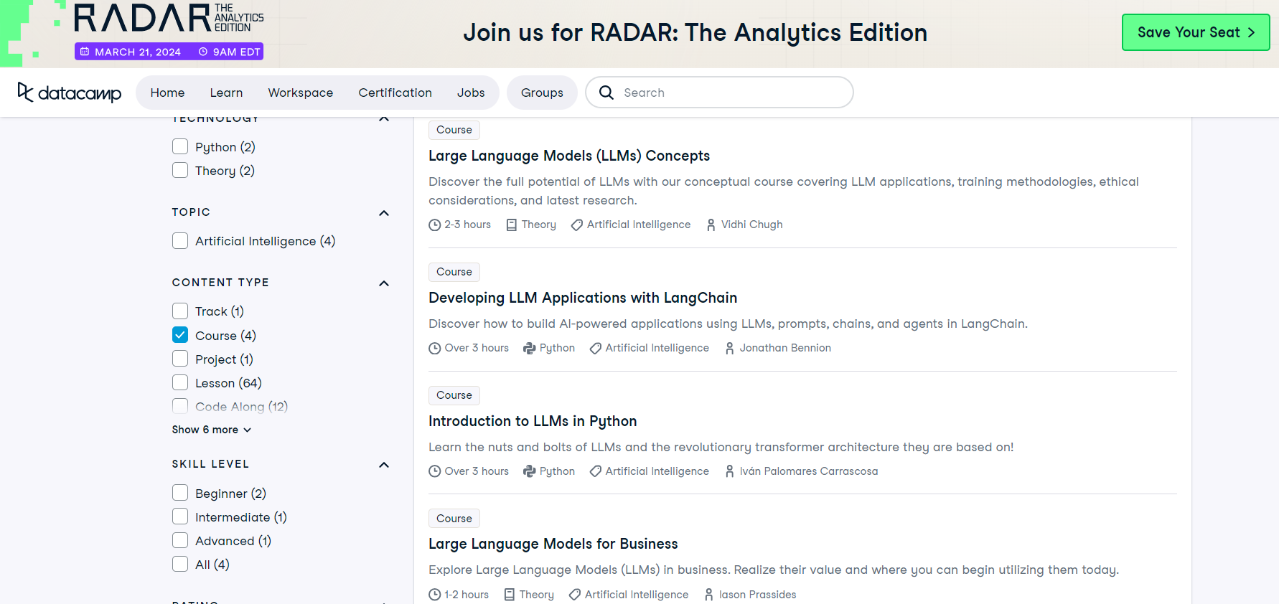
Learn LLMs on DataCamp

Slide 27
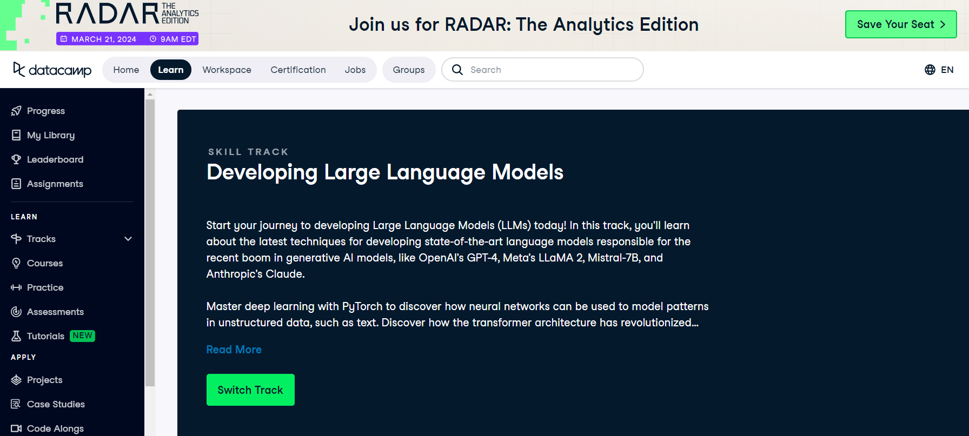
Learn LLMs on DataCamp

Slide 28

Win DataCamp License
for Free
Application link:
http://bit.ly/DataCampML SASIBAU

Slide 29
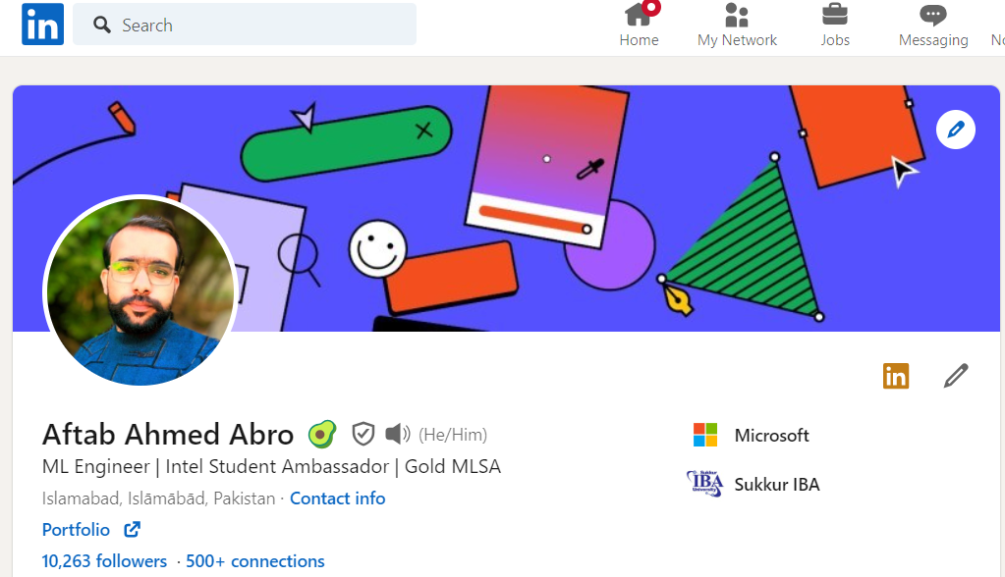
About Organizer
This exceptional event was brought to you by the MLSA Club Sukkur IBA University, in collaboration with Aftab Ahmed (Gold MLSA), with generous support from DataCamp.
29

Slide 30
Thanks ☺
30

